Slide 1


BUS281A: Hands on Data Science w. Python Mike Ames
Wake Forest
School of Business
_______
BUS281A

Slide 2
Data Science & Business Analytics
Data Analytic Thinking: Make decisions based on analysis of data.
Replace intuition with data driven analytical decisions
Extract value from and treat data as an assets
Increase pace of actions
Be more competitive
Agility
OODA Loop : Boyd: The Fighter Pilot Who Changed the Art of War

Slide 3

Crisp Data Mining (1996)
Clickbait – New framework for data science, machine learning, or analytics
ftp://ftp.software.ibm.com/software/analytics/spss/support/Modeler/Documentation/14/UserManual/CRISP-DM.pdf

Slide 4

Real Example of Data Science
What’s up with NYC’s exploding manholes?
The problem is worst during winter months, when nearly 60 percent of manhole incidents occur, thanks to the mixture of melting snow and de-icing salt seeping into manholes, causing frayed low-voltage cables to fail. In turn, that causes fires, smoke and explosions that can send manhole covers flying.
Maniacal manholes, at a glance
Five-Year Average of Incidents:
Explosions (results in injury to persons or property): 29
Fire: 140
Open covers (manhole dislodges, but no injury reported): 37
Smoking manholes: 2,241
https://www.metro.us/whats-the-deal-with-nycs-exploding-manhole-covers/
Notes:
In NYC the peak demand for electricity is rising.
The infrastructure dates back to the 1880’s from the time of Thomas Edison.
Power failures occur fairly often (enough to do statistics) and are expensive to repair
We want to determine how to prioritize manhole inspections in order to reduce the number of manhole events (fires, explosions, outages) in the future.
This is a real problem.

Slide 5
Business Understanding / Objective
What do you really want to accomplish?
“predict manhole fires and explosions before they occur.”
What are the constraints?
What are the risks?
How will you evaluate the quality of the results?
For manhole events :
Goal 1: Assess accuracy of predicting manhole events before they happen.
Goal 2: Determine how often manholes need to be inspected.

Slide 6
Data Understanding
A mix of “Structured & Unstructured”
Trouble tickets – free text documents typed by dispatchers documenting problems on the electrical grid.
Records of information about manholes
Records of information about underground cables
Electrical shock information tables
Extra information about serious events
Inspection reports
Vented cover data

Slide 7
Data Preparation
Cleaning, Transforming & Engineering
Turn free text into structured information:
Trouble tickets turned into a vector like:
Serious / Less Serious / Not an Event
Year, Month, Day
Manhole Covers
Geolocation
Labeling
Identifying Manholes that exploded and those that didn’t
Try to integrate tables (create unique identifiers)
Join manholes to Cables,
half of the cable records disappear

Slide 8
Model Building
Predictive Modeling synonymous with ML
If you want to answer a yes/no question, this is classification.
For manholes, will the manhole explode next year? Y/N
If you want to predict a numerical value, this is regression.
If you want to group observations into similar-looking groups, this is clustering.
If you want to recommend someone an item (e.g., book/movie/product) based on ratings data from customers, this is a recommender system.
Note: There are many other machine learning problems.

Slide 9
Evaluation
How Accuracy? Precision? Recall?
How do you measure the quality of the result?
AUC / ROC charts useful but kind of Naïve
Evaluation can be difficult if the data do not provide ground truth.
This anything with safety is a trade off between recall and precision
Precision – TP / (TP + FP )
Recall – TP / (TP + FN)
High recall, low precision. Our classifier casts a very wide net, identifies lots of exploding manholes, but also a lot of non-exploding.
High recall, high precision. The holy grail, our fish net is wide and highly specialized. We identify a lot of exploding manholes while minimizing the number of false positives.
For manhole events, we had engineers at Con Edison withhold high quality recent data and conduct a blind test.

Slide 10
Week 1
Syllabus
Getting Started
Get Python & Jupyter Setup
Create your First Notebook
Data Camp Overview
Pandas 101 Notebook

Slide 11
And our journey begins…
Analytic Software & Technology
Coding 50% mechanics / 50% cognitive
Writing Matters
Written documents emphasize substance over style, force organization of thought, give control to the reader, generate better questions and feedback, and create a timeless reference.
Get your spelling and grammar right.
Ensure that your document identifies title, author and date.
Be concise!
Coding Matters
You can’t do data science without writing code.
Specifically Python.
Organization Matters
Projects
Code
Commentary

Slide 12
The “Design Pattern”
It’s a process and a journey
Stage
Get data into a common format
Structure
Shape (join, filter, aggregate)
Cleanse
De-dupe, standardize etc.
Transform
Create new and useful variables
Visualize
Tables, Statistics & Graphs
Model
Inferences & Predictions

Slide 13
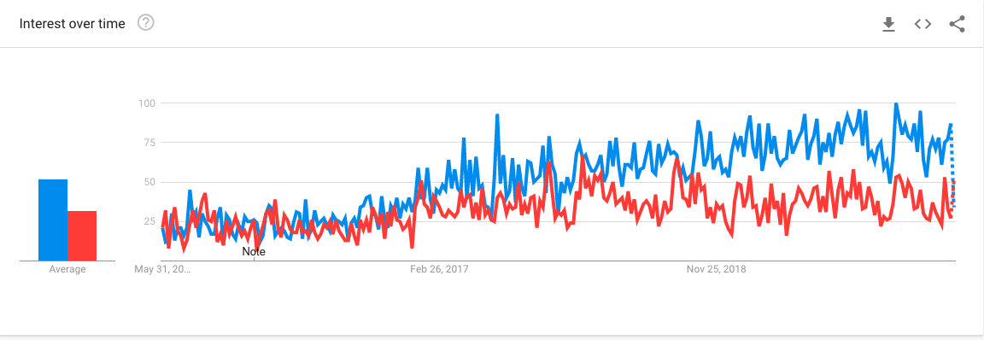
Why Python?
#1 language for Data Science, R is a close second.
The first place to look.
Build just about anything w. Python
”Relatively” easy to learn

Slide 14
Syllabus
Overview
This is an intense and action-packed course for anyone interested in data science or pursuing a career in data science. This course has been designed to provide you a solid foundation in real-world Data Science and Machine Learning techniques.
Live Sessions and Office Hours
Office Hours: Mondays and Wednesdays from 9:30 to 10:45am, ET (or 1:1 by appt)
Live Sessions: Tuesdays and Thursdays 9:30 to 10:45am ET
Text Book
Python Data Science Handbook Essential Tools for Working with Data
By Jake VanderPlas
Publisher: O'Reilly Media; 1 edition (December 10, 2016)
ISBN-10: 9781491912058
Jake has made his book freely available here: https://jakevdp.github.io/PythonDataScienceHandbook/

Slide 15
Syllabus
Note on expectations & collaboration
This is a in intense course, collaboration is encouraged and recommended! Just turn in your own work! You’ll get out of this course what you put into it. You should fully expect to spend significant time on assignments and projects to get the most out of the course.
Late policy
This is a fast-paced course, which requires strict schedule adherence. Due dates for assignments and projects are published on the course calendar. Work turned in by 11:59pm ET on the due date will be considered “on time”, assignments / projects received after the due date will be accepted up to 24 hours late for a 10% penalty, assignments received after that point will not be accepted and receive a zero.

Slide 16
Grading
Grading:
Weekly Assignments (10%), Data Camp Assignments – Develop Python Skills
Weekly Projects (60%), Case-based projects – Emphasis on business understanding
Final Exam (40%, due 7/2) , Kaggle style – Emphasis on predictive accuracy
General thoughts:
Like anything, you’ll get out this class what you put into it.
This class is foundational, you’ll want to apply these skills going forward
Keep your code organized, handy, clean and accessible.
Pull from it going forward.
Notes:
there are something like a dozen homework assignments, every other week we’ll have a online Zoom session, and we have two “real-world projects” for the mid-term and final.
like any class you take, online can be somewhat challenging - you’ll get out of this class what you put into it
this class is foundational, and if you want to make yourself more marketable earn significantly more $$, developing your analytic programing skills will payoff in short order.
finally, keep your code handy; almost all good programmers are good scavengers, i reuse old code all the time, find snippets on the internet; simple things like indentation and some comments everyonw and again will make your life so much easier.

Slide 17

Data Camp
Use your Wake Forest email to signup!
Here are two invite links, if one doesn’t work use the other one
https://www.datacamp.com/groups/shared_links/9f6086c93f50e8d4aa52bb1de257115f6ee45109c9d52402ebc13073ac2b61d5
https://www.datacamp.com/groups/shared_links/7d61e3049a69ba7225a5ddbb2e4304e86df3f4a8dbdd005f5bd6cfb8b0ba135b
Data Camp is the easiest way to initially learn python syntax.
We have about a dozen assignments.
Take them in chunks i.e. don’t try to do them all in one sitting.

Slide 18
Projects
There are 4 projects
Churn
Churn part 2
Promotions
Loan Default
And a Final
Fraud Detection
Projects build on each other
Start with a business rule
Then move to a decision tree
Random Forests
Gradient Boosting
And other methods
Evaluation is a key theme
Accuracy
Confusion Matrix
ROC/AUC
FPR vs TPR

Slide 19
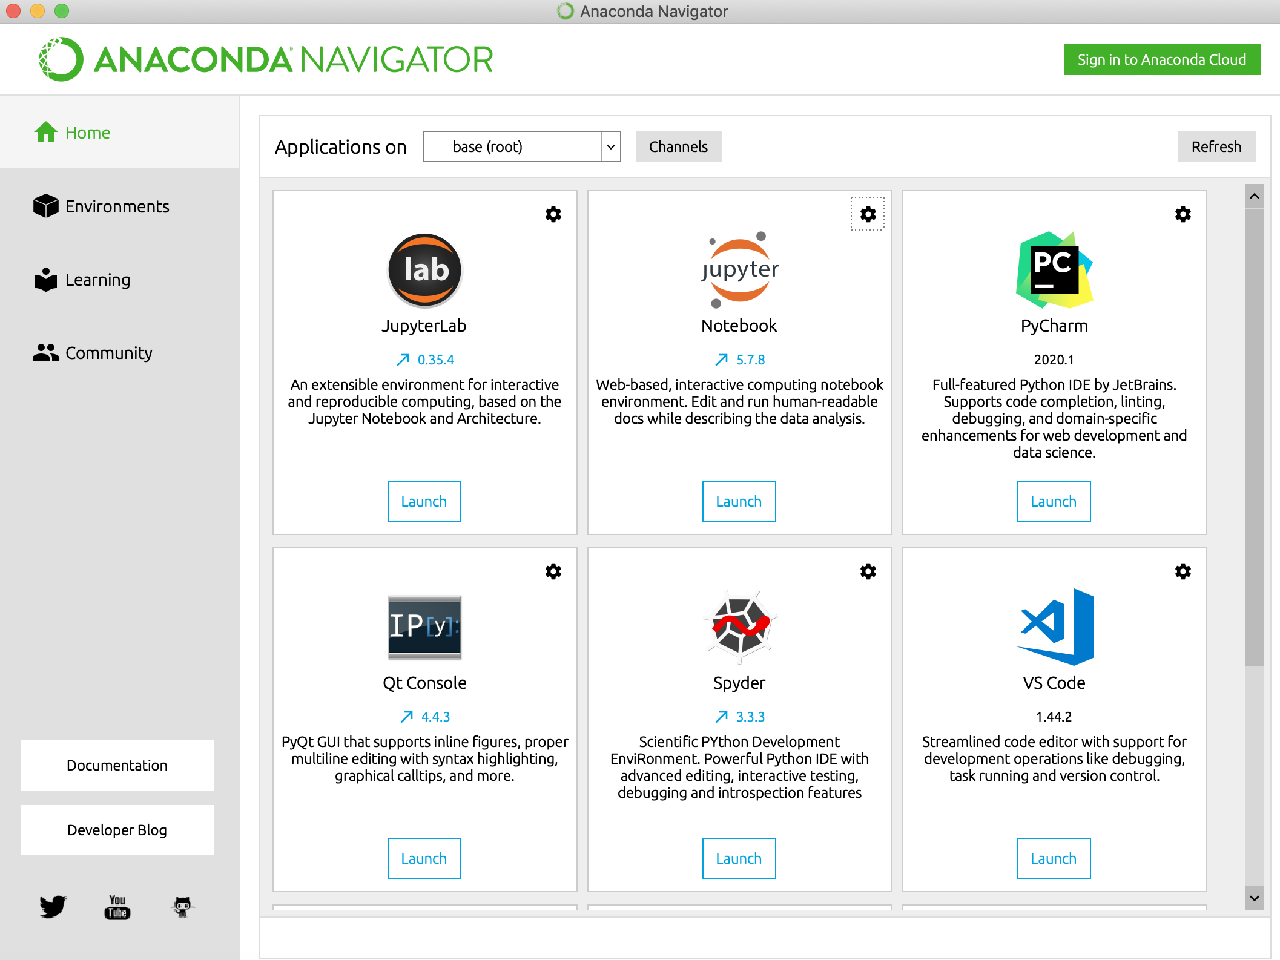
Setup & Install Python & Jupyter
We will be making use of Python 3.7, the easiest way to get your hands on it is to download it from Anaconda. Once downloaded follow the instructions to setup and install python 3.7. Once installed fire up Anaconda Navigator. We’ll be using Jupyter notebooks going forward.

Slide 20

Setup & Install Python & Jupyter
Recipe
Download & Install Anaconda
https://www.anaconda.com/products/individual
We are using python 3.7, 64bit
Anaconda installs most packages we need by default
We’ll install packages as we need them using pip
Our key packages
https://pandas.pydata.org/
https://scikit-learn.org/stable/
https://matplotlib.org/
https://seaborn.pydata.org/

Slide 21
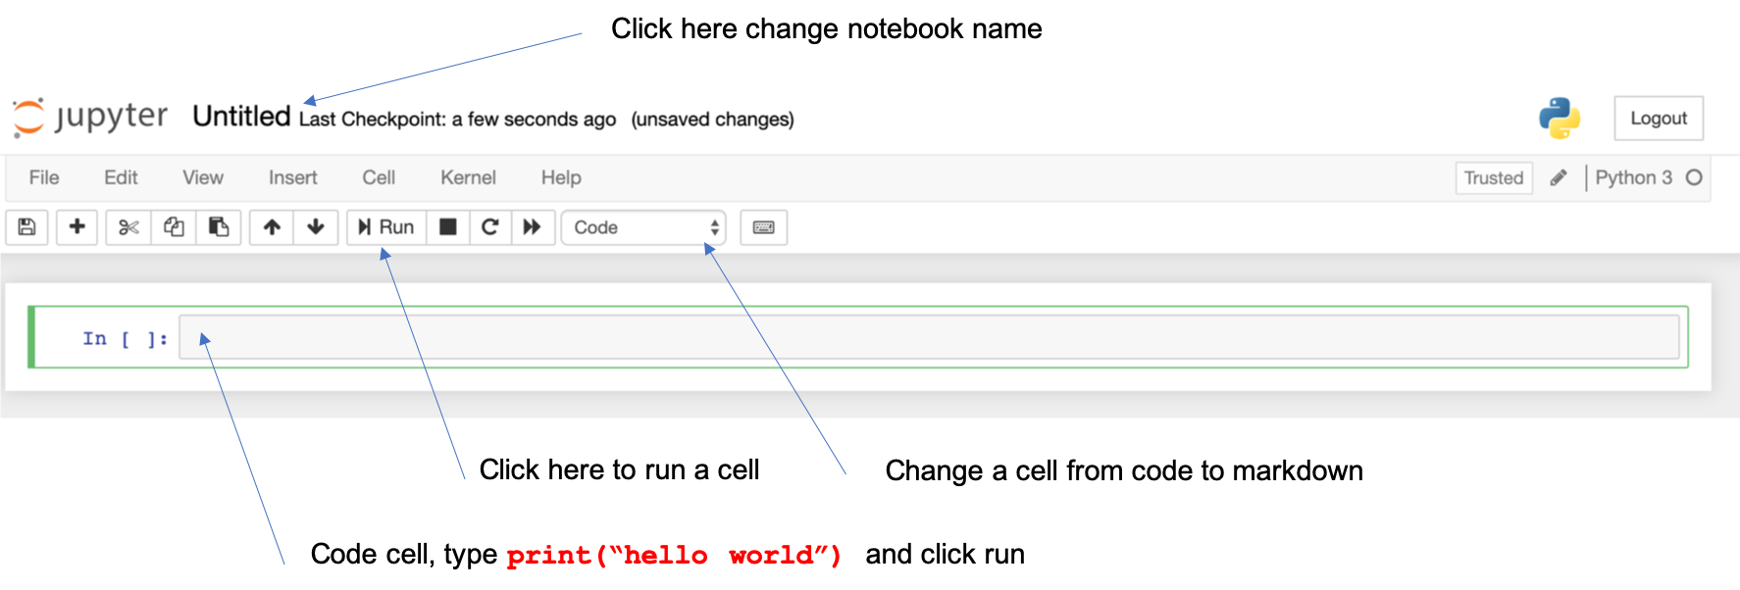
Your First Notebook
Launch Jupyter, and create your first notebook.
Note: you may be prompted for a token in order to log into your notebook, you can find that in the terminal that Jupyter opens up on your computer

Slide 22
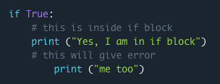
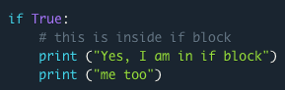
Python Syntax
Python is case sensitive. thisIsDifferent than ThisisdifferenT
Paths python uses forward slashes /
C:\folderA\folderB path should be C:/folderA/folder
There is no command terminator, several languages use a ;
Quoting python supports ‘single quote’ and “double quotes”
Comments are done with a #
# this is a comment
print ("Hello, World!")
Code Indentation! This is the most important rule of python programming

Slide 23
Components of a Python Program
Libraries, Modules and Packages
It’s all the same thing. They expose specific functions within.
Numpy and Pandas are packages we’ll use every time
Functions
Package/Module specific
User authored
If you have to do it more than once write a function…
Code Basics
Indent
Logic
Print
Loops
Lists & Dictionaries
Input / Output
Mostly we’ll be reading writing from a CSV file but you could do SO MUCH more.

Slide 24
Goals and Objectives
Develop key programing skills with Python
Import/export data
Structure, Aggregate and shape data AKA – Wrangling Data
Graph, chart and visualize data
Manipulate strings and text , convert strings to numbers, and back
Apply conditional logic
Generate descriptive statistics
Apply common analytic transformations
Build visual applications
Author functions
BUILD pipelines and train models!
80/20 Rule
80% of time is spent preparing data, 20% of time is spent analyzing.
Notes:
The thing that separates the analytic professionals from one another, is their skill in manipulating data across many platforms.
I think almost all of our exercises take advantage of real-world data. you’ll hear people often lament that 80% of their time is doing data preparation and 20% of their time is doing analysis, i think that is a little trite sound bite that software vendors like to throw around, yes a lot of time is spent manipulating data - you should spend your time manipulating it! The framework for data analysis that i use, and wish spelled something cute, boils down to a series of phases and i organize my programs around these phases:
Phase 1. Acquiring, Importing & Stage data
Phase 2. Structuring data (Sort, Aggregate, Join, Transpose)
Phase 3. Profile for Quality (Descriptive & Qualitative)
Phase 4. Cleansing & Transformation (also known as Feature engineering - ranges everything from missing value handling, clustering, pca, etc. )
Phase 5. Exploratory Data Analysis ( Descriptive, Univariate, Multivariate, etc)
Phase 6. Modeling & Validation
Phase 7. Integration
Phase 8. Monitoring
Phase 9. Rinse Repeat

Slide 25
Our goal this week...
Basics of Python and Jupyter Notebook
Install and Configure Python and Jupyter
Build a Syntax Cheat Sheet
Perform basic exploratory analysis
STAGE
Import / Export CSV data
STRUCTURE
Join / Merge
ANALYZE
Create a number of charts with matplotlib
COMMUNICATE
Use Markdown to produce results

Slide 26
Week 1 – Getting Started Summer 2020
Wake Forest
School of Business
_______
Hands on Data Science

Slide 27

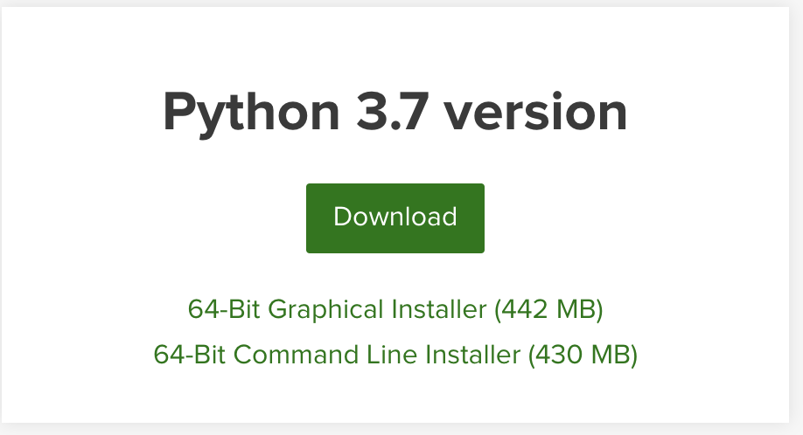
Setting up Python
https://www.anaconda.com/distribution/
Download and Install it. Use python 3.7!

Slide 28
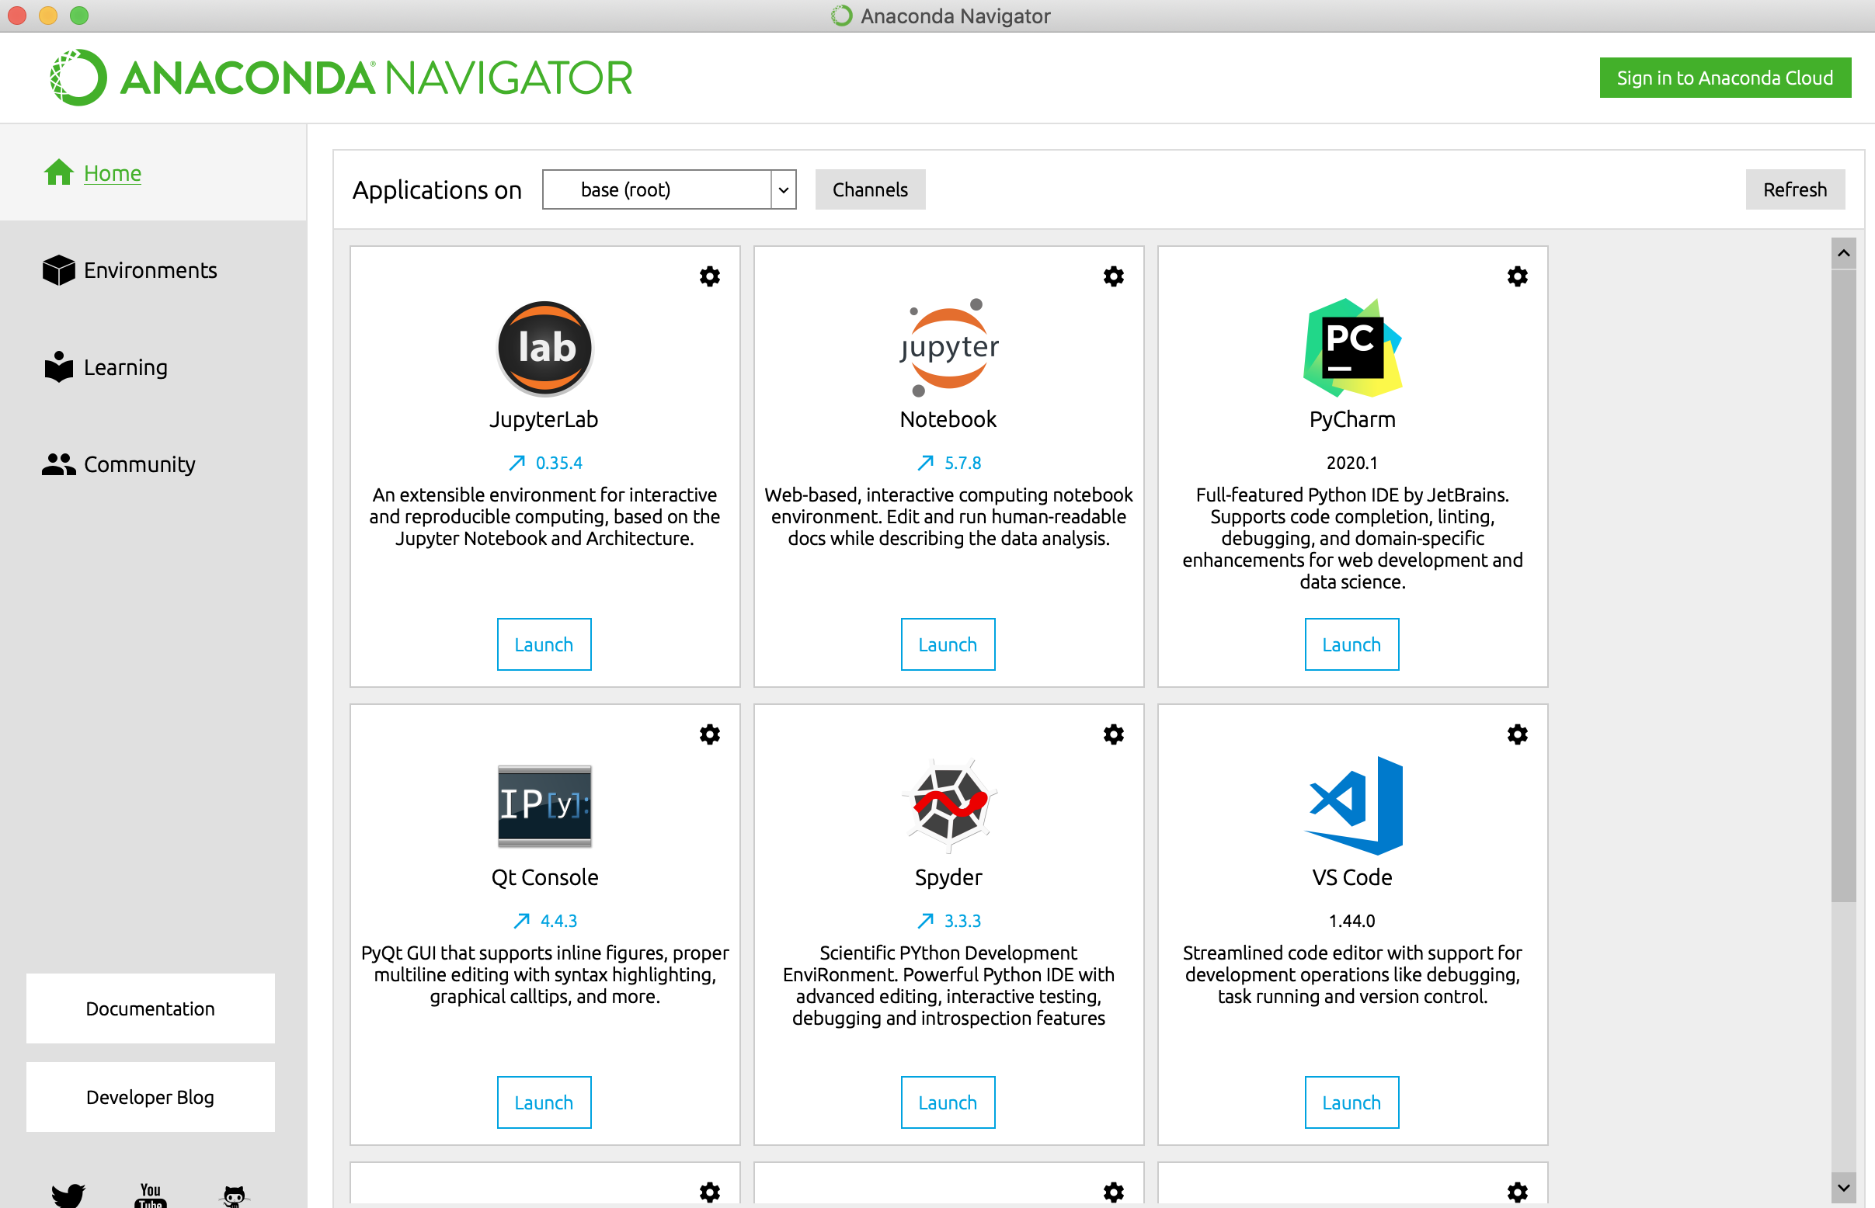
Anaconda Navigator

Slide 29
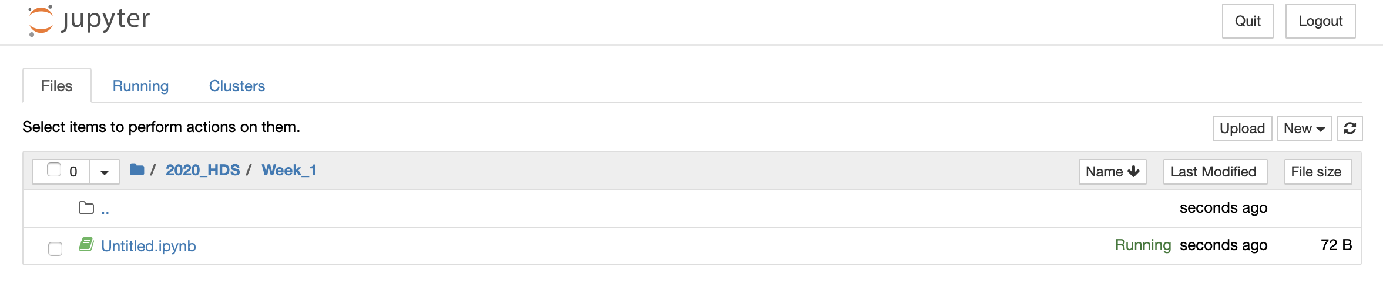
Jupyter Notebooks
Just points to a directory on your computer.
Step 1. make a folder for the class
Step 2. make a folder for the week
Step 3. create a notebook
New Notebook -> Python3

Slide 30
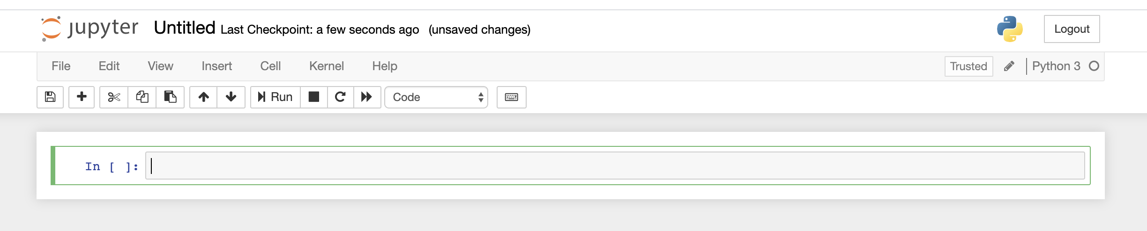
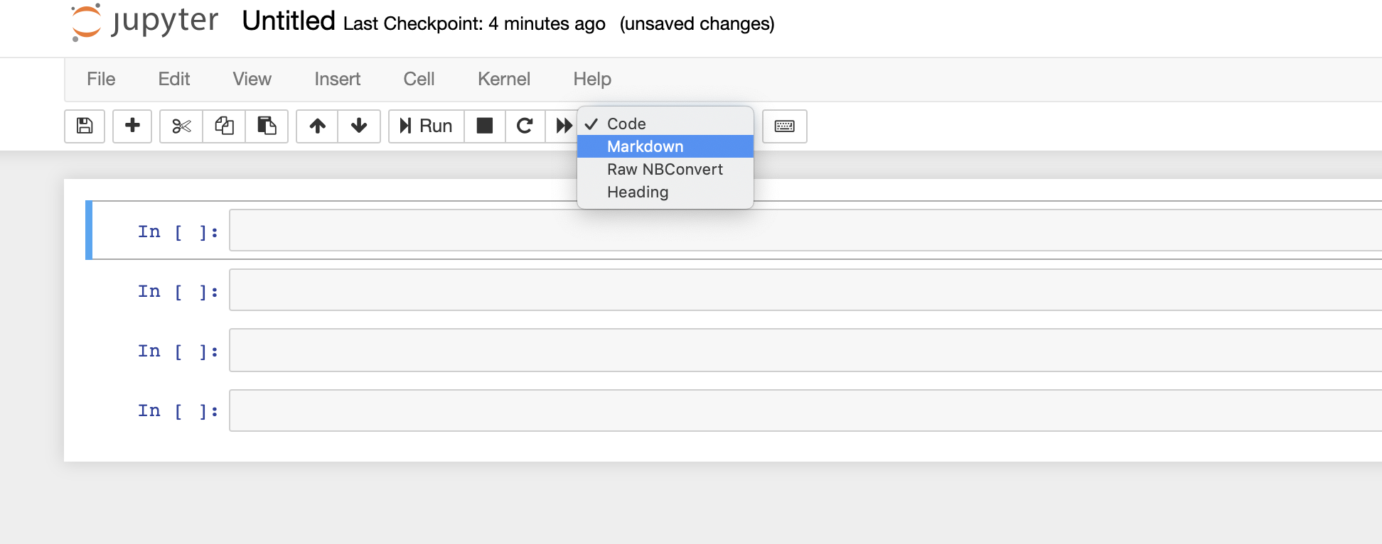
Your first Notebook
Notebook name, click and change it.
There are two types of cells we’ll be using
- Code
- Markdown

Slide 31
Quick and Dirty Python
Libraries & Packages
Simply a collection of functions and methods typically for a purpose.
Popular packages
Matplotlib
Numpy
Pandas
Sklearn
Datetime
Random
Install packages via command line
>pip install pandas
>conda install pandas

Slide 32
Pandas
DataFrame also known as a Table
Simply a Table with an index, rows and columns
df.loc[row_indexer, column_indexer]
Index | Column1 | Column2 | … | ColumnN
0
1
…
N
Row
Column

Slide 33
Pandas
Datatypes
Pandas supports the following data types
Numeric
Float
Integer
Character
Datetime
List
Dictionary

Slide 34
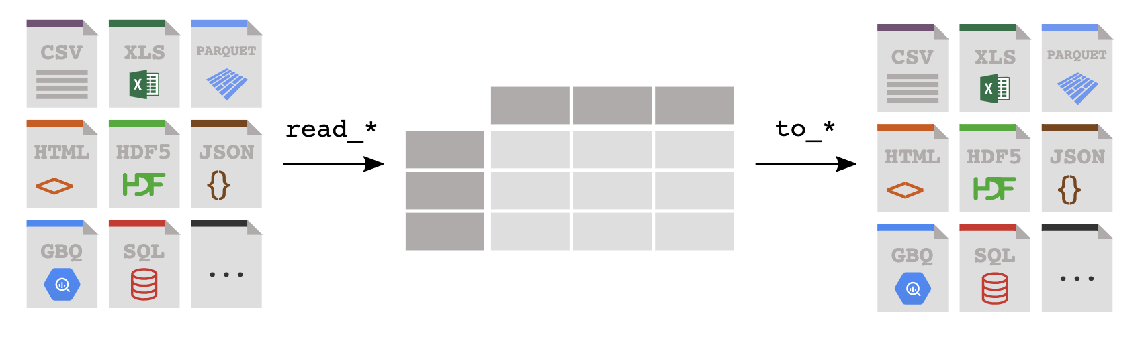
Pandas
Reading & Writing Data
Reading
df = pd.read_csv(‘myfile.csv’)
Rwrting
df.to_excel(‘myfile.xlsx’)
You read data from a file or database into a Pandas DataFrame, and you write from a DataFrame to a file or a database, the key is get data into Pandas!

Slide 35
Pandas
Series?
Think of it as a single column DataFrame
newSeries = df[“Column1”]
Series
Index | Column1 | Column2 | ColumnN
0
1
…
N
Index | Column1
0
1
…
N
=
> type(df[”Column1"])
% pandas.core.series.Series
https://pandas.pydata.org/pandas-docs/stable/reference/api/pandas.Series.html

Slide 36
Pandas
How do I “select specific columns”
Select specific ”columns” = [[ ]] – “bracket bracket”
newDataFrame = df[[ ”Column1”, “Column3”]]
DataFrame
Index | Column1 | Column2 | ColumnN
0
1
…
N
Index | Column1 | Column3
0
1
…
N
=
> type(df[”Column1"])
% pandas.core.frame.DataFrame
https://pandas.pydata.org/pandas-docs/stable/reference/api/pandas.DataFframe.html

Slide 37
Pandas
How do I “select specific rows?”
Select specific ”rows” =
queryResult = df[df[“Column1] == “value”]
DataFrame
Index | Column1 | Column2 | ColumnN
0
1
…
N
Index | Column1 | Column3
0
1
…
M
=
In [6]: type(df[”Column1"])
Out[6]: pandas.core.series.Series
https://pandas.pydata.org/pandas-docs/stable/reference/api/pandas.Series.html

Slide 38
Pandas
Conditional Operators
Pandas supports the common operator stuff
equal to: df[df[”column”] == “some_value”]
not equal to: df[df[”column”] != “some_value”]
greater than: df[df[”column”] > some_number ] (>,>=, <, M=)
In a list df[df[”column”].isin(a_list)]
use the squiggly “~” for not in a list, df[~df[”column”].isin(a_list)]
Multi-Conditions (&|)
AND: df[ (df[“column1” != “value”) & (df[“column2”] > some_nbr)]
OR : df[ (df[“column1” != “value”) | (df[“column2”] > some_nbr)]

Slide 39
Pandas
Useful functions
df.columns – returns a list of the names of the data frame’s columns
df.dtypes – provides the data types of your columns
df.info() – concise summary of dataframe
df.describe() – provides summary statistics of your DataFrame’s numeric columns
<class 'pandas.core.frame.DataFrame'>
RangeIndex: 3333 entries, 0 to 3332
Data columns (total 21 columns):
state 3333 non-null object
account_length 3333 non-null int64
area_code 3333 non-null int64
phone 3333 non-null object
 | count | mean | std | min | 0.25 | 0.5 | 0.75 | max
account_length | 3333 | 101.064806 | 39.822106 | 1 | 74 | 101 | 127 | 243
area_code | 3333 | 437.182418 | 42.37129 | 408 | 408 | 415 | 510 | 510
vmail_message | 3333 | 8.09901 | 13.688365 | 0 | 0 | 0 | 20 | 51

Slide 40
Pandas
df.query() a better way to filter rows …
Fast & readable queries for filtering rows.
Reference columns without quotes
Supports operators BUT concatenate conditions with “and”
df.query('area_code == "415" and \
intl_plan == "yes" and \
day_mins < 100 and \
state == ["WI", "OR", "WY"]')
state | area_code | phone | intl_plan | day_calls | state | day_mins | day_charge | eve_calls | eve_charge
WI | 415 | 355-7705 | yes | 92 | WI | 62.3 | 10.59 | 82 | 23.38
OR | 415 | 378-6772 | yes | 67 | OR | 12.5 | 2.13 | 90 | 21.81
WY | 415 | 412-3726 | yes | 117 | WY | 95.9 | 16.3 | 131 | 13.56

Slide 41
Pandas
df.query() reference
@ character identifies a variable to be evaluated rather than a column name, and lets you efficiently evaluate expressions.
mean_calls = df['day_calls'].mean()
state_list = ["WI", "OR", "WY"]
df.query('area_code == "415" and \
intl_plan == "yes" and \
day_calls < @mean_calls and \
state == @state_list')
state | area_code | phone | intl_plan | day_calls | state | day_mins | day_charge | eve_calls | eve_charge
OR | 415 | 332-9460 | yes | 87 | OR | 176.2 | 29.95 | 81 | 12.33
WI | 415 | 421-9401 | yes | 91 | WI | 264.3 | 44.93 | 115 | 13.68
WI | 415 | 355-7705 | yes | 92 | WI | 62.3 | 10.59 | 82 | 23.38
WY | 415 | 406-1349 | yes | 78 | WY | 189.6 | 32.23 | 117 | 22.73
WI | 415 | 339-6637 | yes | 97 | WI | 126.9 | 21.57 | 102 | 14.19

Slide 42
Lets go see some code…

